Slide 1
ICPI Tableau Training Pre-work June 2018
Contact: icpi@state.gov

Slide 2
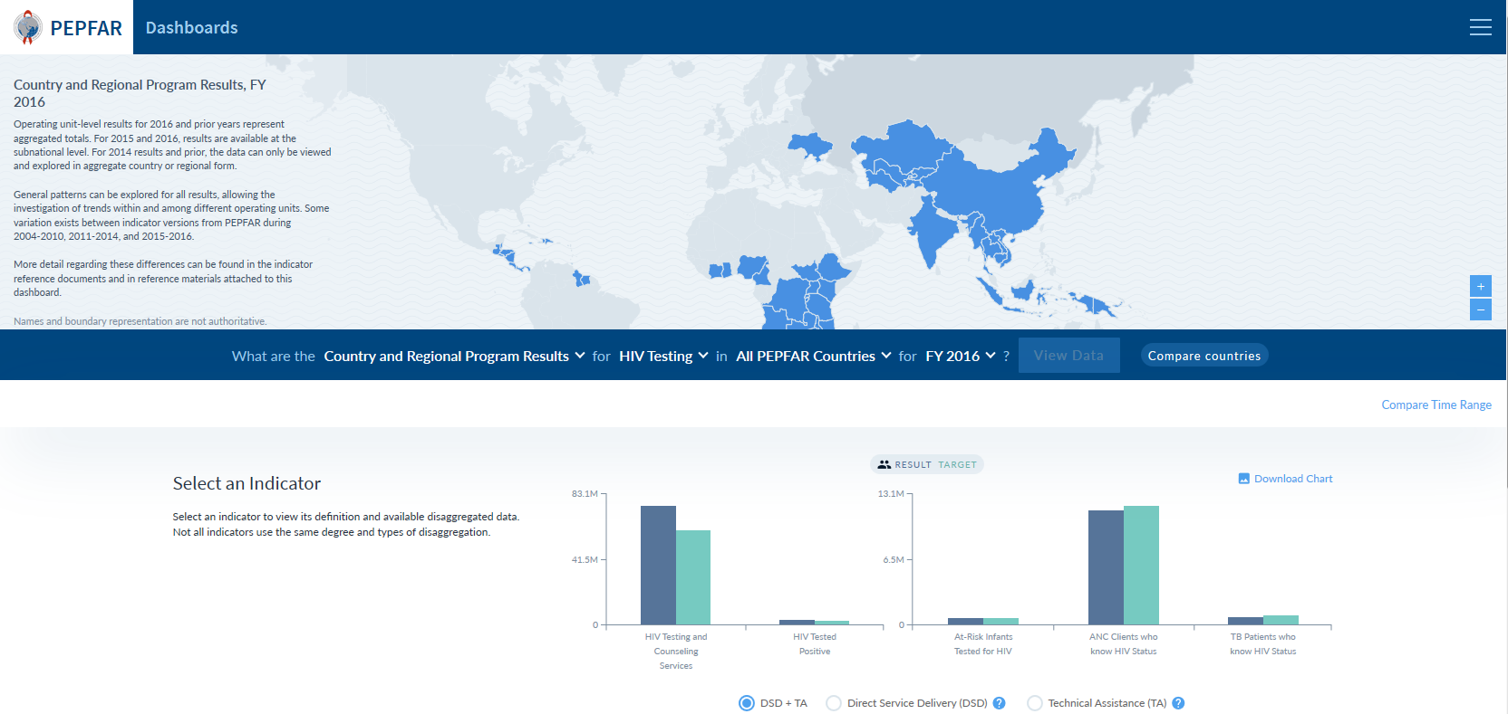
The task: Recreate a visual from PEPFAR public dashboards
This example will walk through HIV Testing, but you can choose any other set of indicators to view with the dataset.

Slide 3
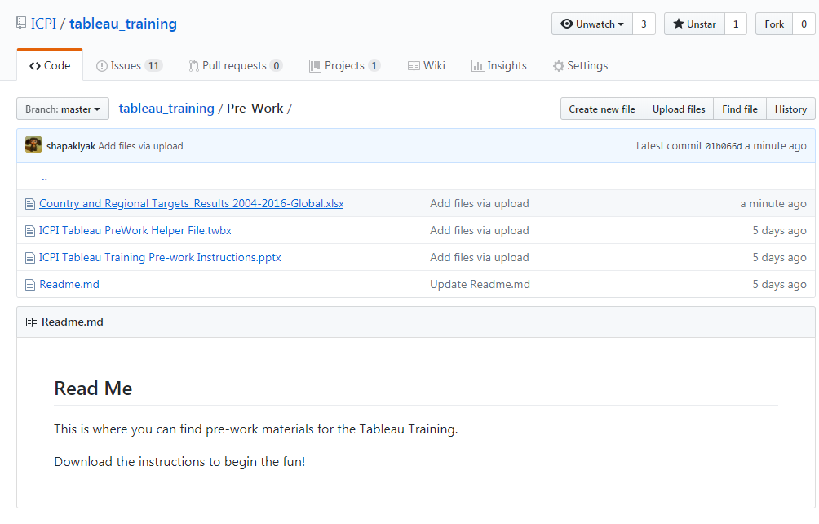
Step 1. Access materials & public dataset
https://github.com/ICPI/tableau_training/tree/master/Pre-Work

Slide 4
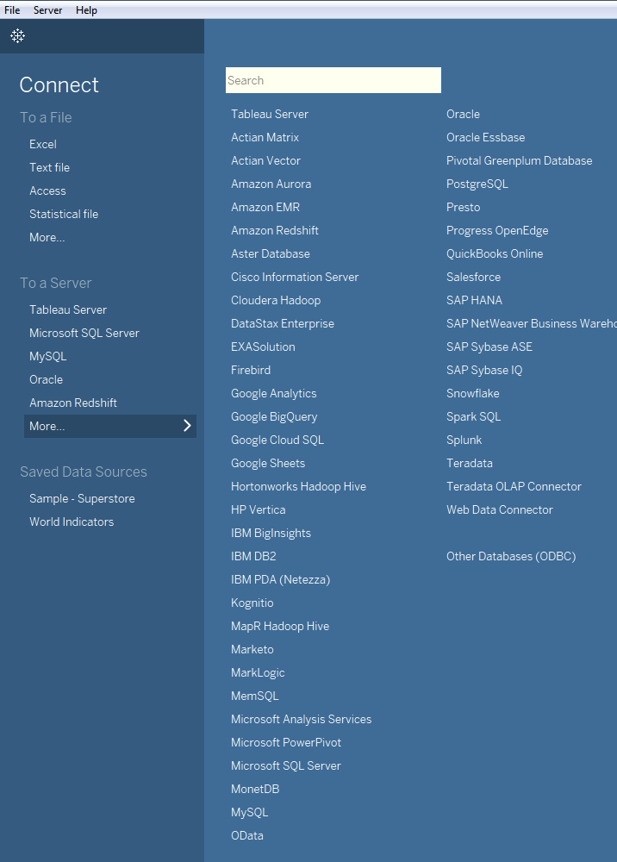
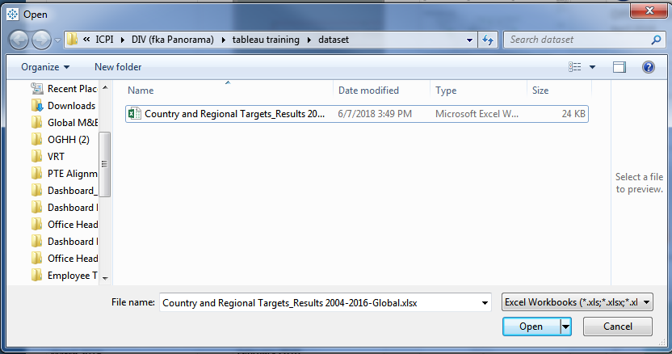
Step 2. Open Tableau Desktop & Connect to your data source

Slide 5
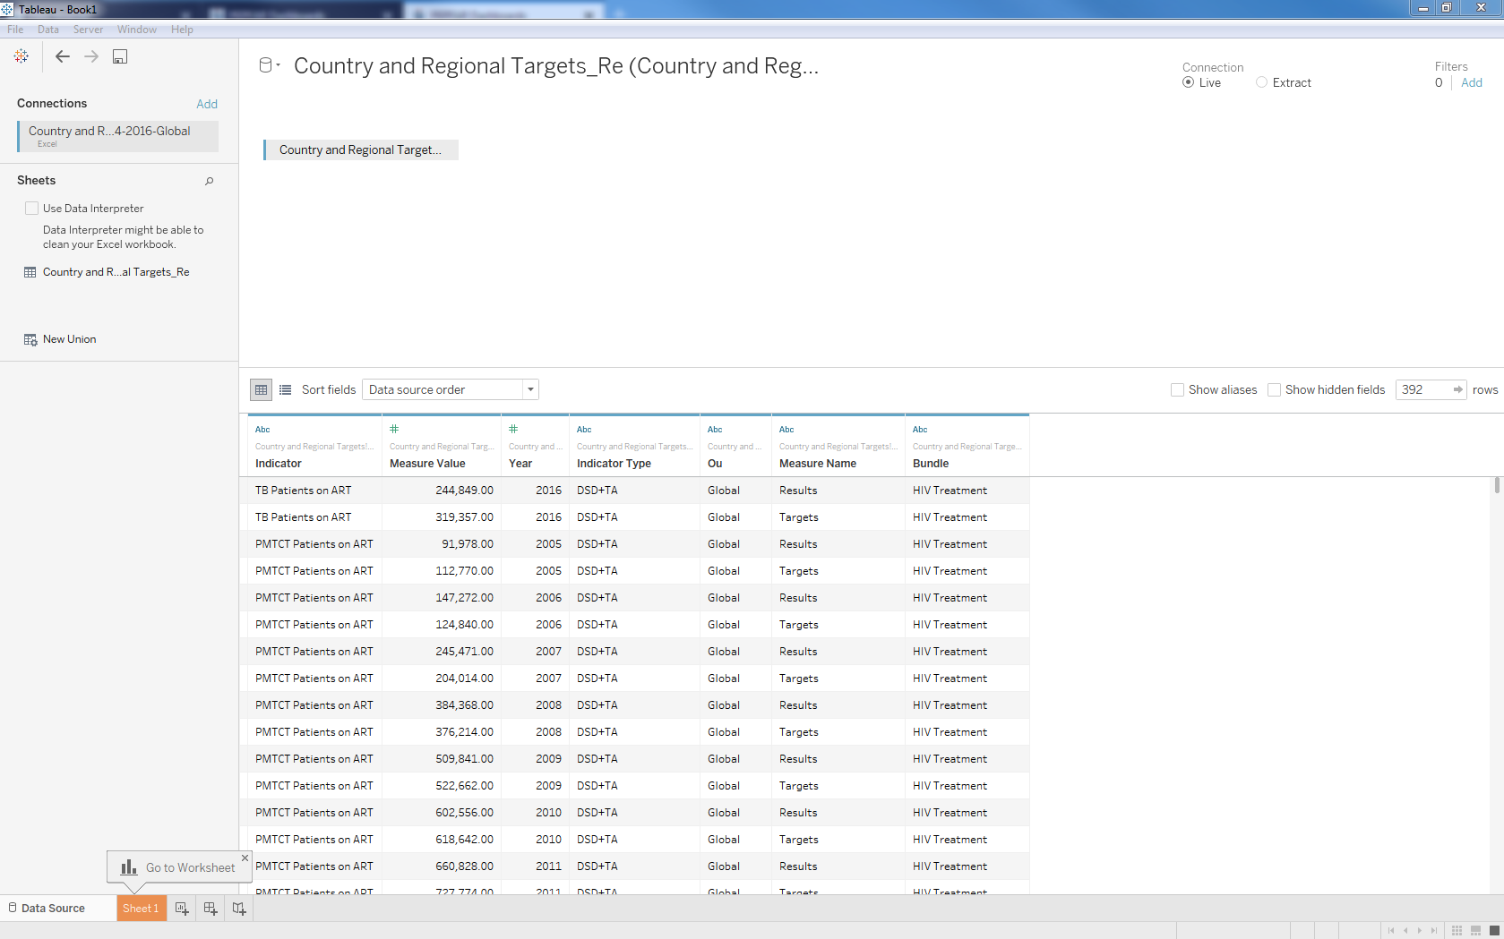
Orientation to the Data Source view - 1
This is the data source name
Live connection or Extract? Think of Extract as subsetting a datasource within Tableau to improve speed with running visuals.
This is the sheet (if using a csv/xls file) that is pulled into Tableau
Note the column headings below

Slide 6
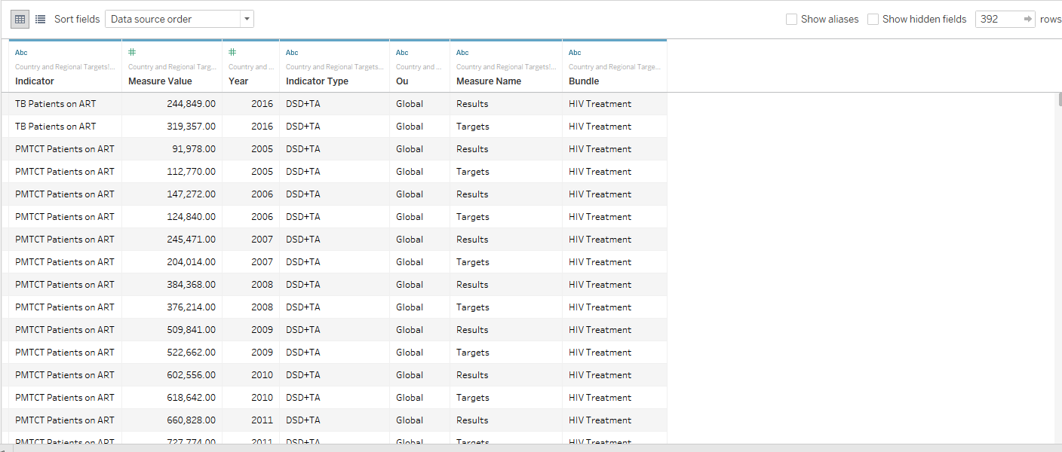
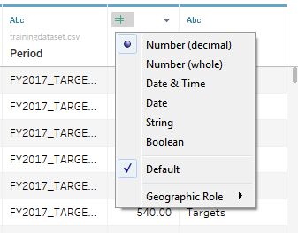
Orientation to the Data Source view - 2
Note the column headings below
Each variable gets pulled in and categorized by type of data: number, date, string, etc.
You can edit the type of data a variable is by click on the “Abc” or # or
You can also edit the type of variable by clicking on metadata

Slide 7
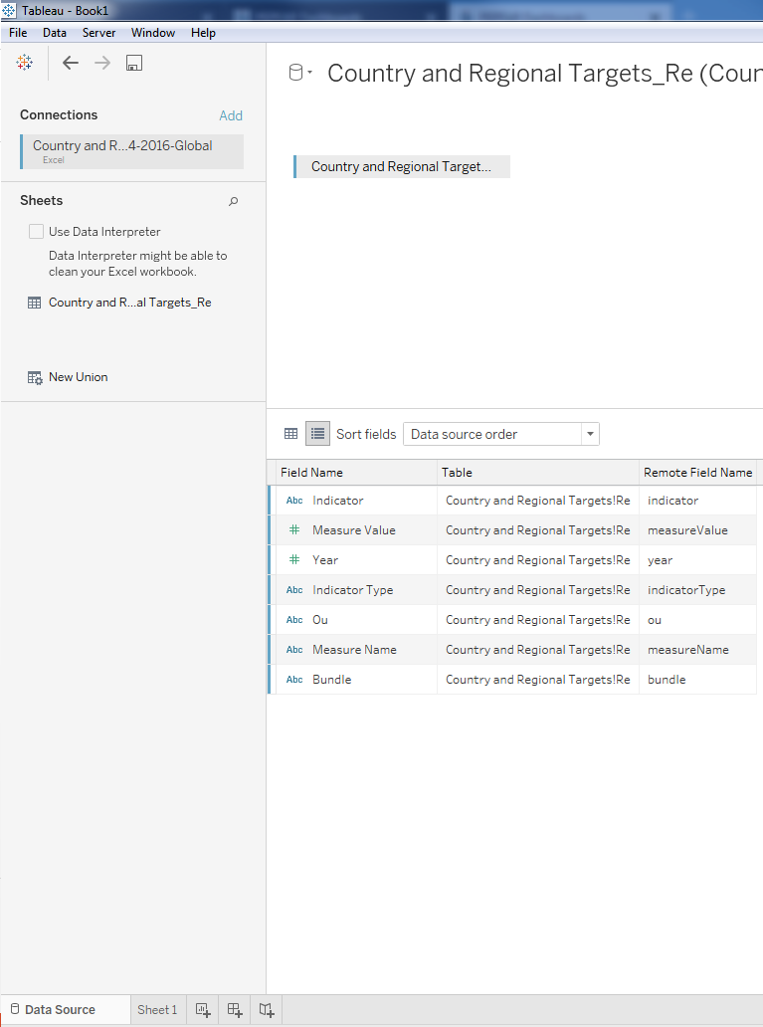
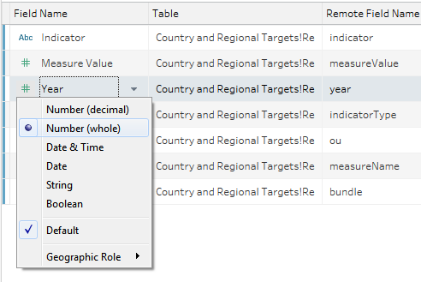
Orientation to the Data Source view - 3 Examine meta data
Here you can also view and edit the types of variables in your dataset
Click on Sheet 1 to get started

Slide 8

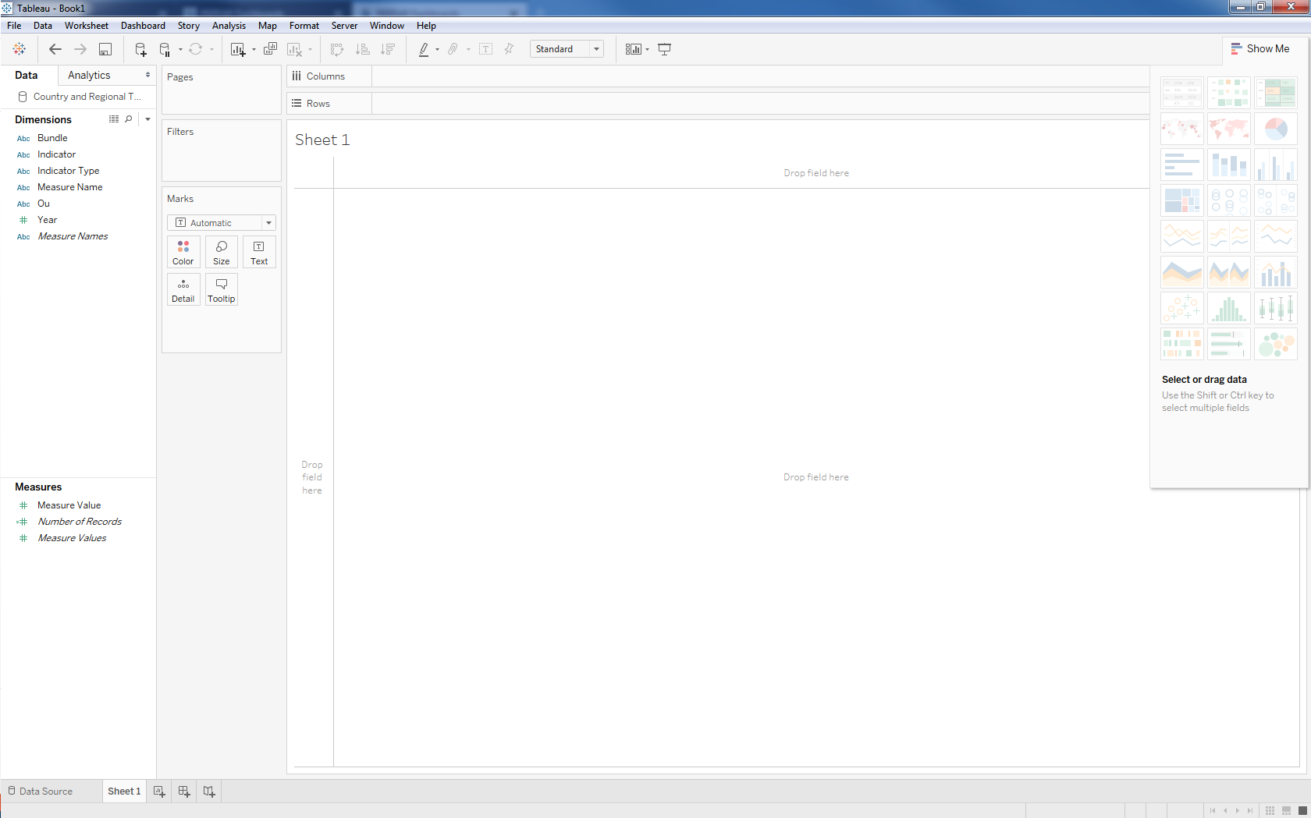
Orientation to Sheets
Think of it as a pivot table in dragging variables to rows & columns
Your Data source is here
Note - Filters
Marks – lets you customize a visual by applying colors, size, labels, tooltips, shapes, etc.
Sample visuals. Hover over and see the tips on how to create this. Good place to start to explore your data
Dimensions= categorical variables
Measures = numerical data

Slide 9
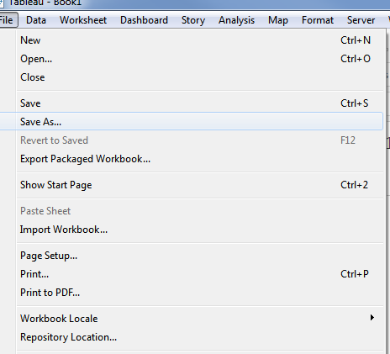
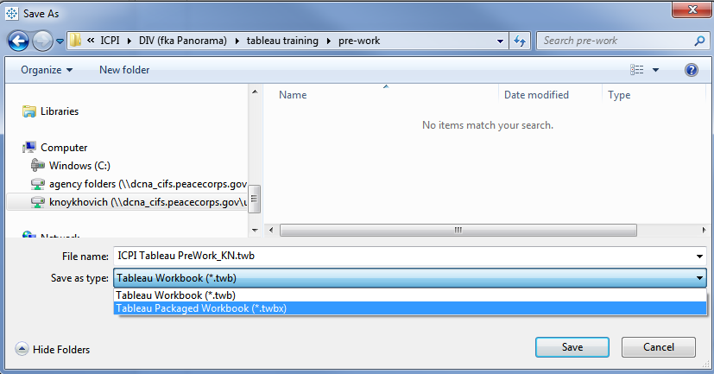
Save your workbook

Slide 10
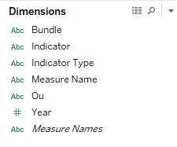

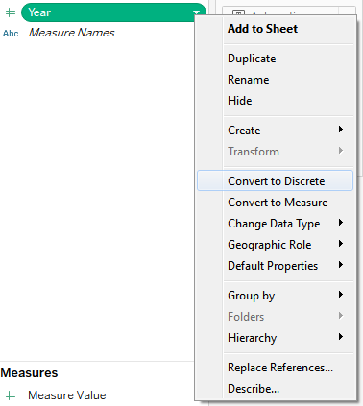
Let’s take a look at our Dimensions
Looks like we have a lot of String data = ABC
We also have Year, which is a
Because it’s green, that means Tableau thinks this is a continuous variable. For this exercise, let’s convert it to a Discrete Dimension

Slide 11
Example #1: HIV Testing in All PEPFAR Countries in FY2016
https://data.pepfar.net/country/impact?country=Global&indicatorGroup=HIV%20Testing&year=2016

Slide 12
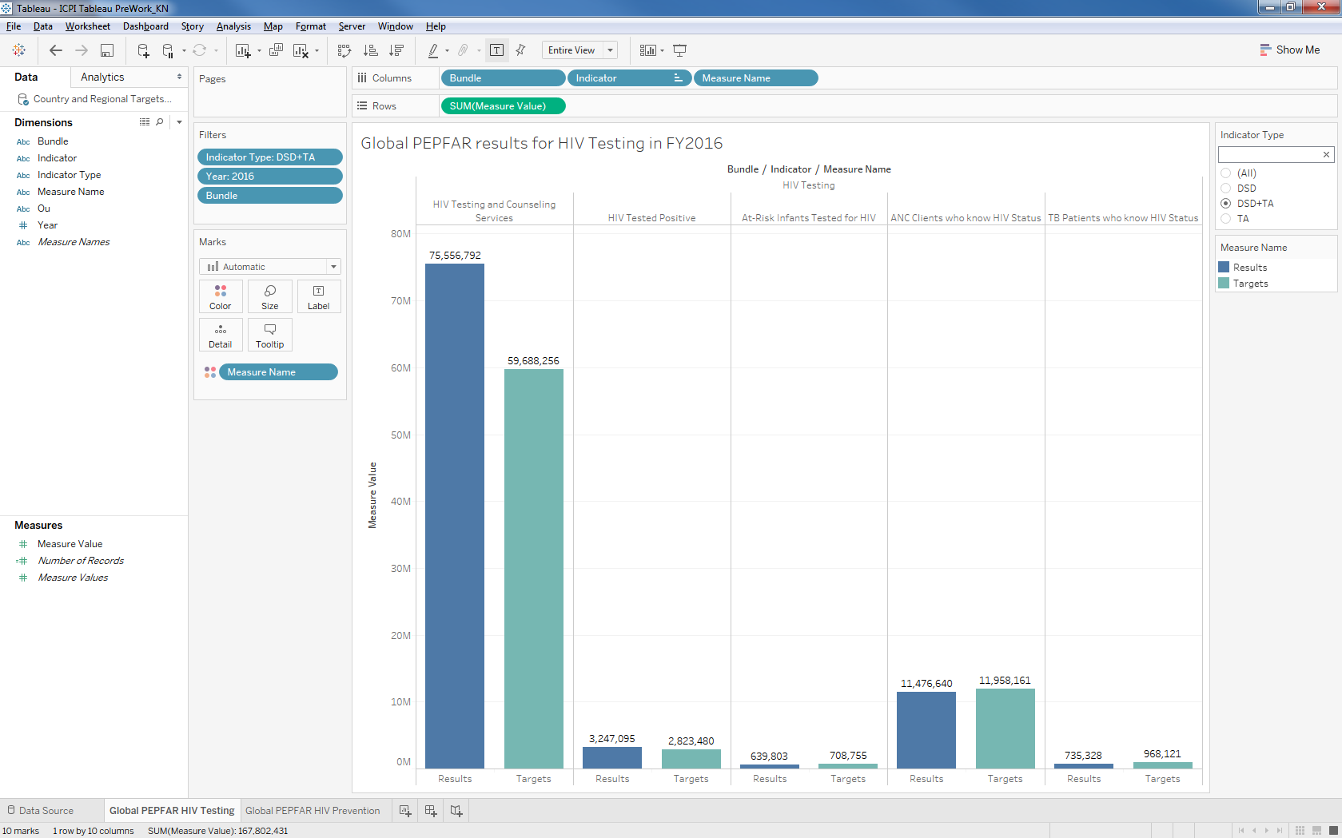
Example #1 in Tableau
QC is your friend! Cross-check your values against the public dashboard

Slide 13
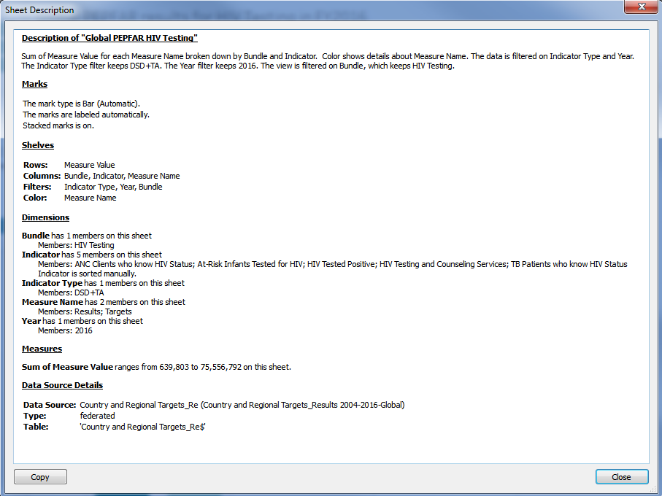
Example # Hint: “Code” for Visual

Slide 14
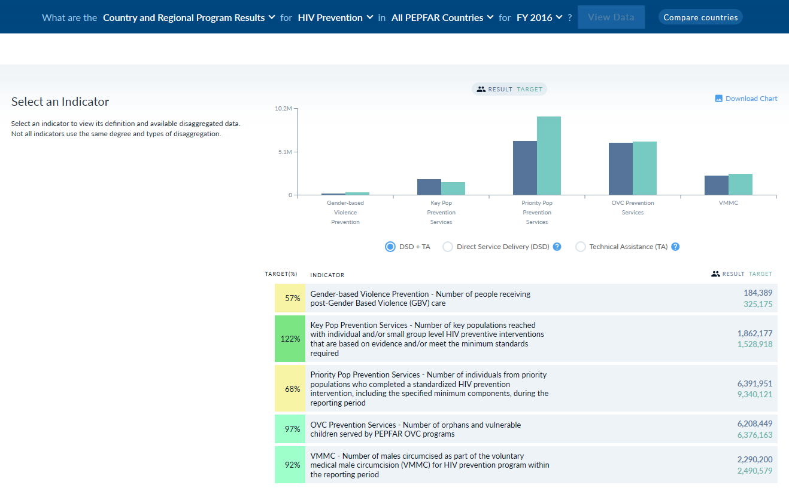
Example #2: HIV Prevention for All Countries in FY2016

Slide 15
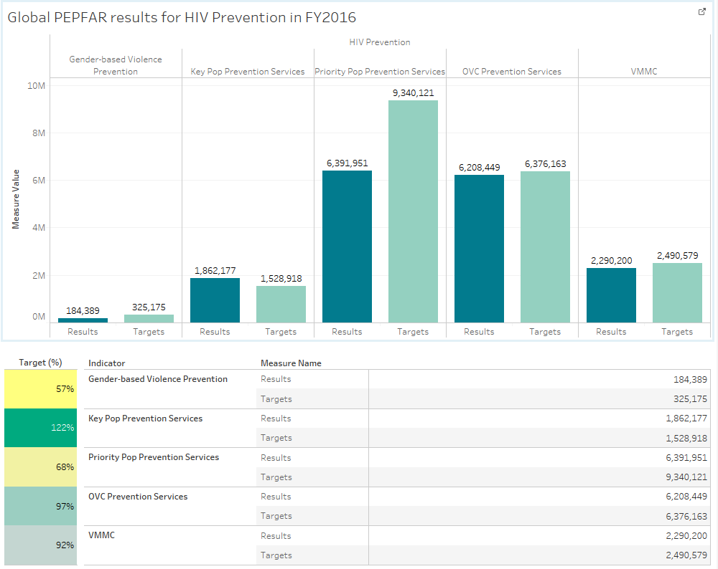
Example # 2 in Tableau

Slide 16
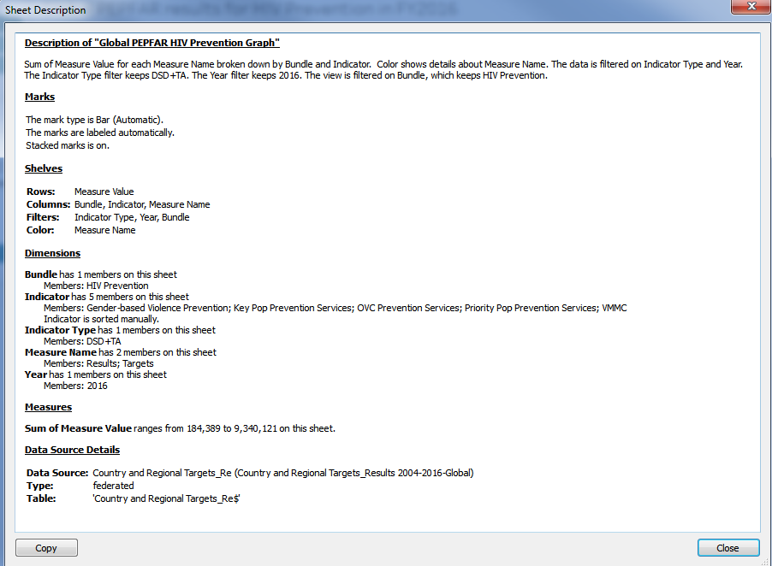
Example #2: “Code” for Visual Bar Graph

Slide 17
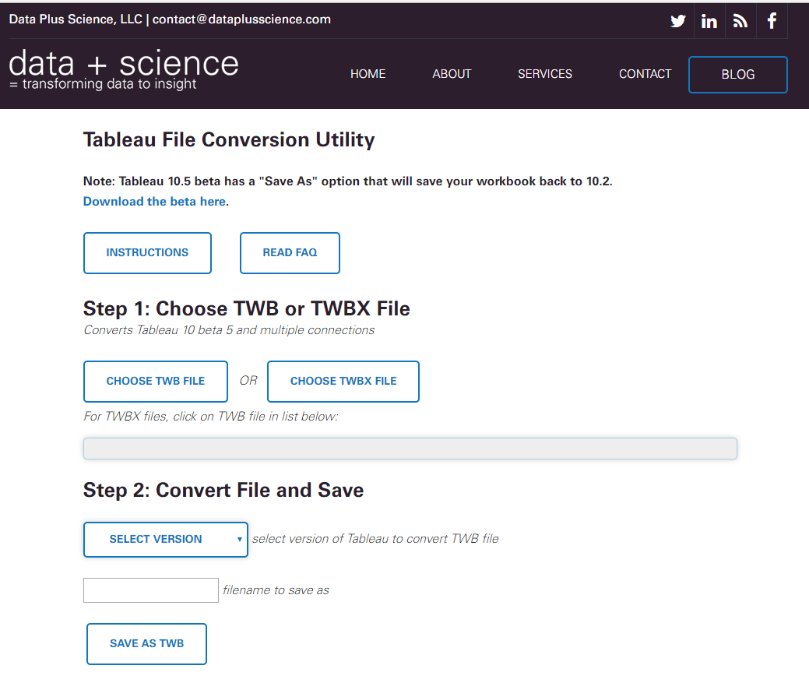
Download the Helper File to see the completed visuals in Tableau
Pepfar.net or
GitHub
The Helper File was created with Tableau Desktop version 10.4. You must have at least version 10.4 to open it. If you do not, then please follow these instructions to convert the file to the version of Tableau you do have.
http://www.dataplusscience.com/ConvertTableau.html

